Slide 1
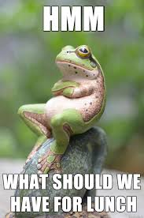

Make Lunch
Great Again
DRI: Kelly Peterson & James Kelley
Jan 2023

Slide 2
Research Goals
Understand existing attitudes and behaviors around lunch to re-imagine the DoorDash lunch experience
Key questions include…
1.
How large is the “eatable moments” market for lunch? Who is ordering lunch?
2.
What are the top considerations influence lunch decision making? How do Cx decide where they will order?
3.
What are the top barriers to ordering lunch/ordering lunch on DoorDash

Slide 3



Research Approach
Meta Analysis of Existing Information
Specifically the team looked at:
  Lunch Behaviors and Aspirations Qual and Survey COMBINED FINDINGS
  A cut by meal from Eatable Moments 2022 | Q4 2022
    Data Tables: EM Tables- Lunch Analysis for KP 01232023
  Report | Lunch Subscription
1:1 Interviews (To be scheduled)
Recommended next steps and approach for follow up 1:1 interviews can be found in the next steps section of this report
Research Brief
Notes:
James to link to failed session

Slide 4
What does lunch look like for DoorDash Cx today?

Slide 5
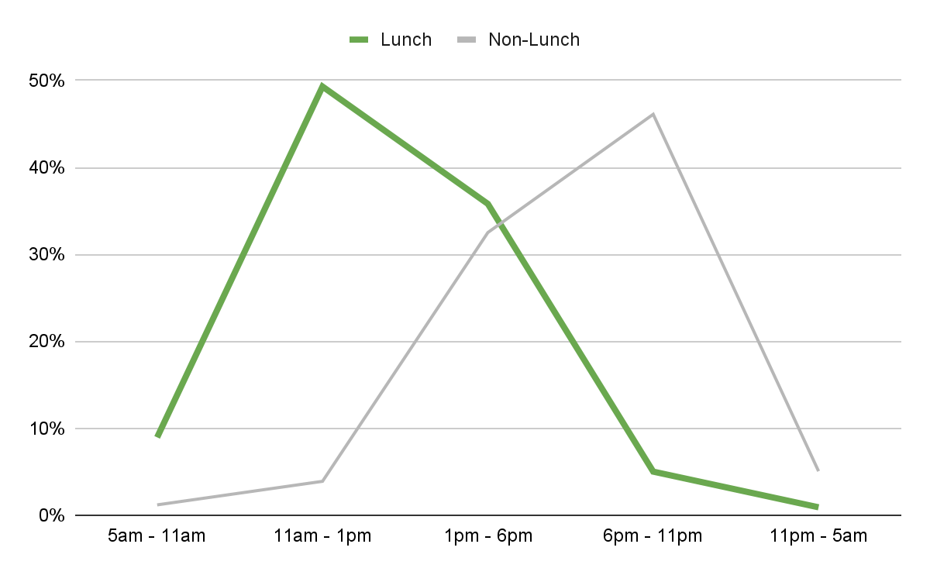
How often do Cx order lunch?
Ordering out lunch is a lower frequency occurrence…
Peak lunch orders occur between 11-1PM*
25%
74%
Lunch represents 25% of all eatable moments among DoorDash Cx*
Of Cx order out lunch once a week or less often according to Lunch specific research conducted in Sept of 2022**
*Source
**Source

Slide 6
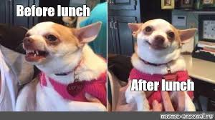
Why do Cx order takeout for lunch?
Lunch ordering typically happens because Cx are in a time crunch, they do not have time to go out or prepare anything and are feeling depleted from their day. They need food fast.
Cx who order delivery do so because they do not have the time to travel
Cx ordering lunch are more likely to indicate they are feeling tired/sleepy/low energy
They are significantly less likely to do extensive research or exploration to decide where to eat
Source

Slide 7
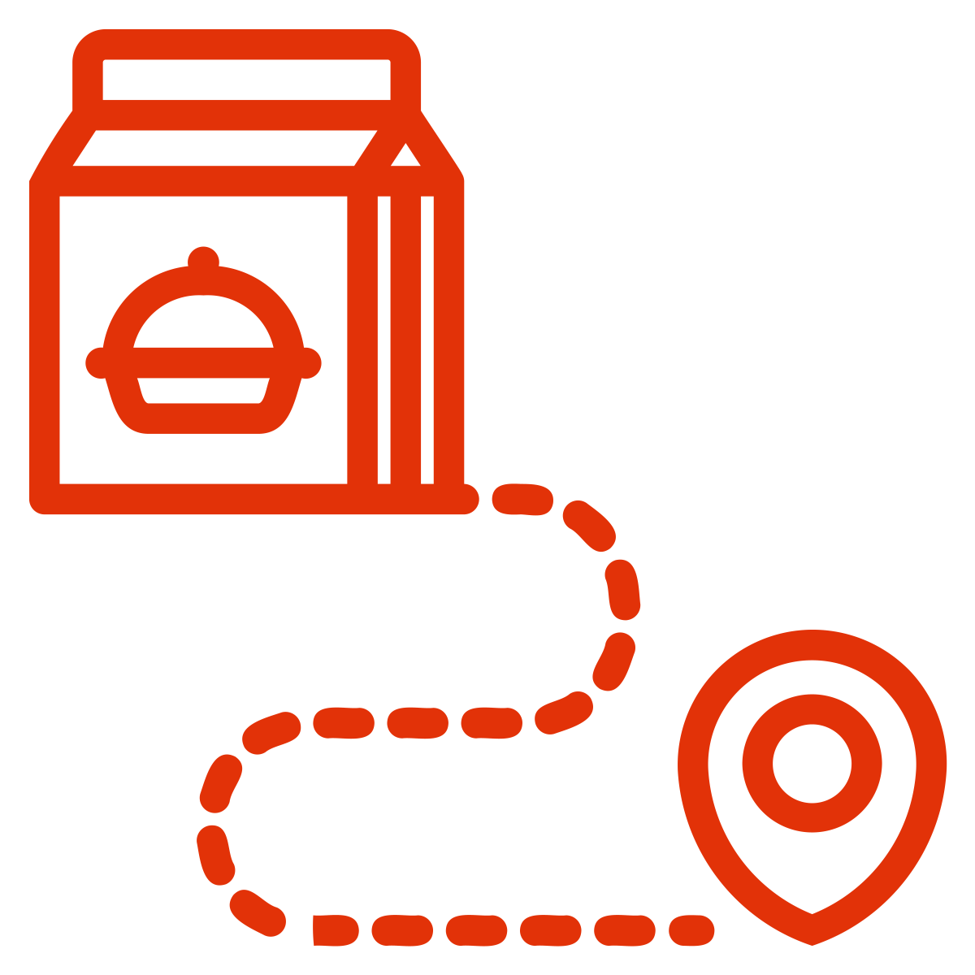
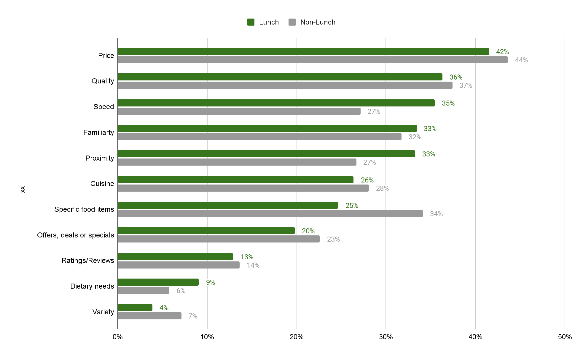
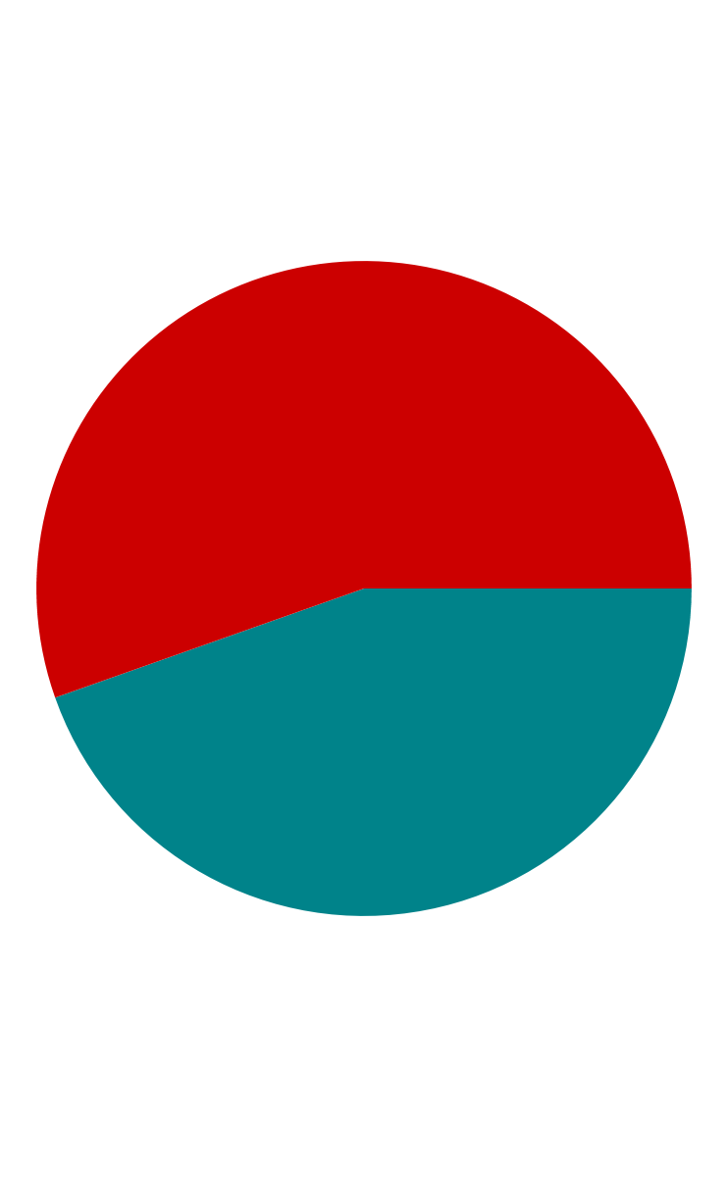
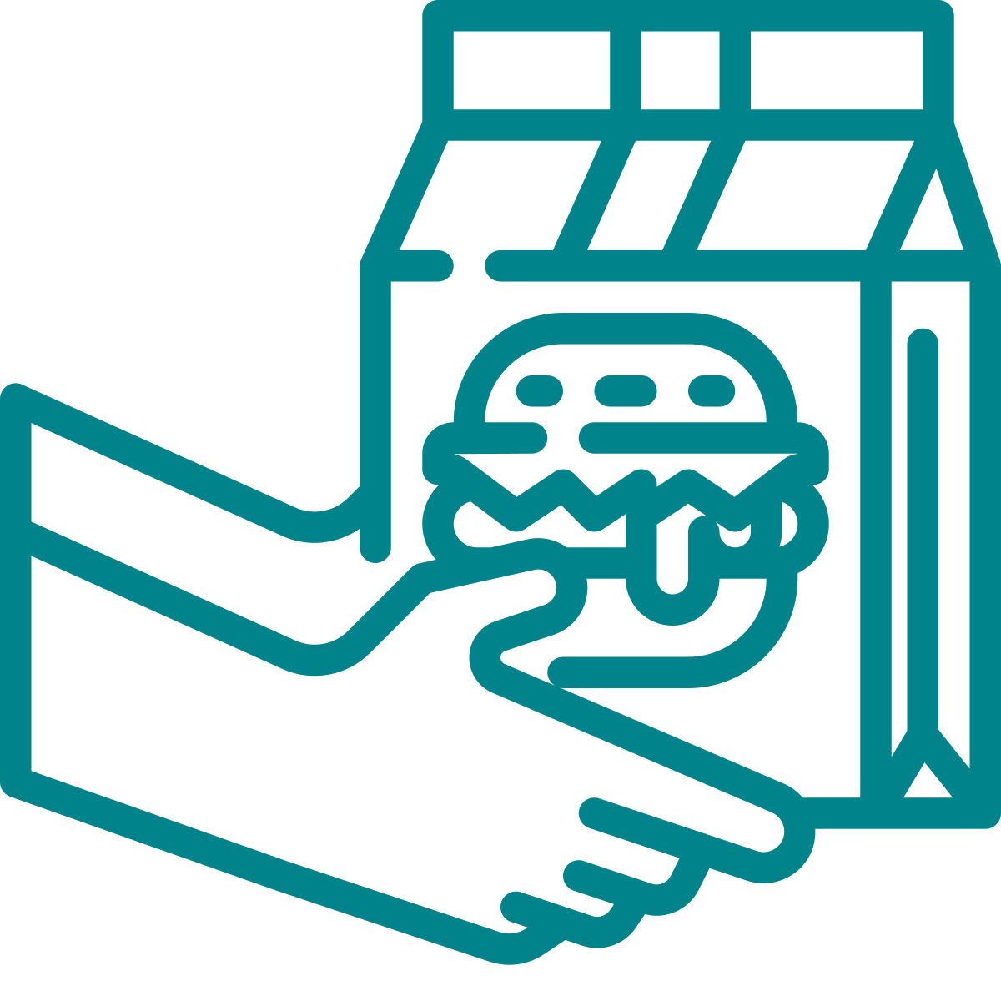
What are the Cx considerations around lunch
Cx have to decide between cost saving at home vs ordering out; when ordering out the most important factors are price, quality and speed. Speed and proximity play a bigger role at lunch than other meals.
Preferred mode of ordering:
Top considerations for ordering:
55% of Cx opt for delivery when ordering lunch.
45% of Cx use pick up functionality when ordering lunch (vs. 39% for other meals)
Those ordering pickup indicate, are slightly more likely to indicate they are grabbing lunch on the way to another location (27% vs. 20%) for other meals).
Source

Slide 8

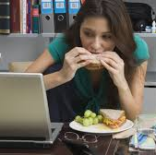

Who is ordering lunch?
Lunch is typically ordered among younger working professionals & students who are eating alone
Those who order lunch tend to be younger & less educated
Those ordering lunch are ordering alone
Lunch is an work event
60% fall in the age range of 18 to 23 (vs. 53% for other meal types)
Those that order lunch are =5% more likely to have income under 50k
No differences in gender, income or geo type (city, rural).
47% of Cx eat lunch alone (vs. 37% for other meals)
Less likely to eat lunch with spouse or children
17% eat in the office vs. (3% for other meal types), less likely to be at home (69% vs. 83% for other meal types)
If lunch is eaten with others, it's more likely to be eaten with business colleagues (14% vs. 2% for other meals)
Source

Slide 9
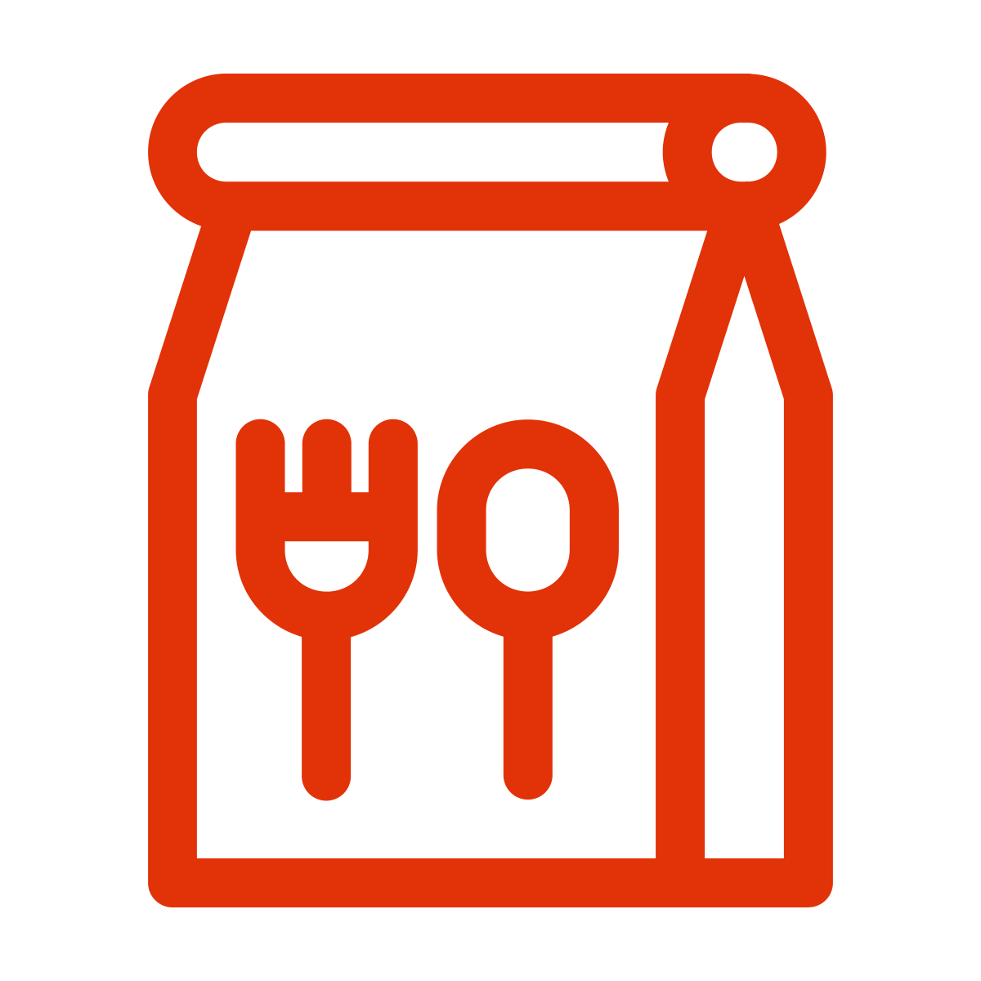
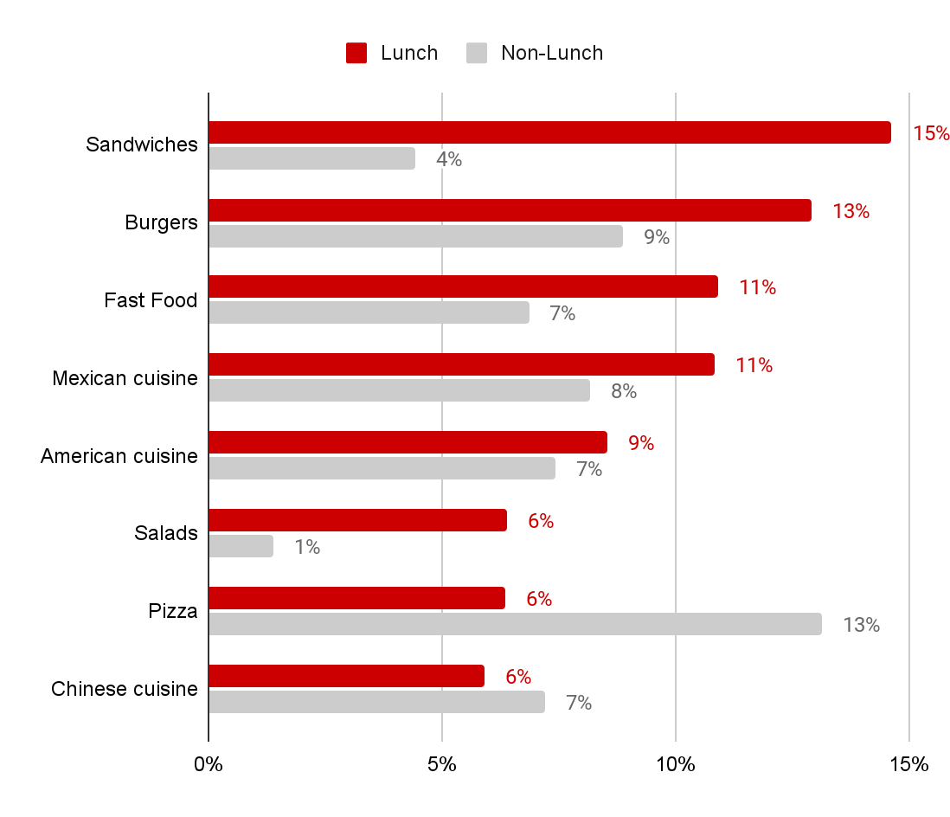
What and where are Cx ordering for lunch?
Cx are looking for quick “on-to-go” type meals (ideally, sandwiches, burgers and fastfood). They will typically order from a Rx they have already successfully ordered from multiple times.
Top cuisines ordered for lunch
Cx are more likely to order from places they’ve ordered from before (especially 10+ times before).
Cx are more likely to know the exact cuisine (65% vs. 60% for other meals), the exact Rx (58% vs. 51%), and items (50% vs. 41%).
Lunches are more likely to consist of entrees/main dishes and less other items (i.e. apps, kids meals, sides, etc.)
Lunch is a “meal on the go” among 13% of Cx
  vs. 5% for other meals
Source
Source

Slide 10
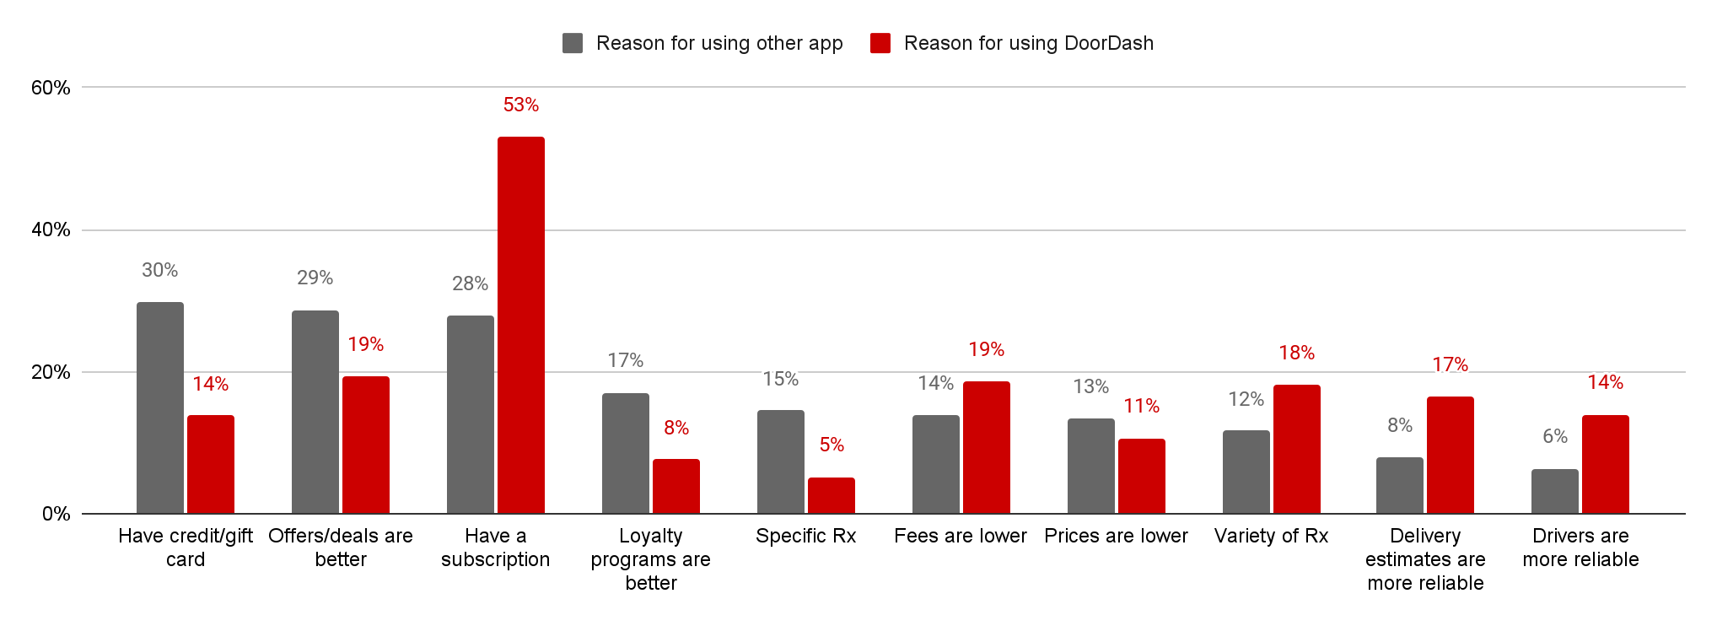

Why not DoorDash?
The top reasons that Cx may use another service include availability of credit, better offers/deals or better loyalty programs.. There is a strong need and affordable option for lunch but it cannot be at the loss of solutions that tackle top needs around speed & proximity. DoorDash can become more competitive with lunch rewards that do not necessarily link to subscription to a program or pre-scheduled lunch.
Reasons from ordering Lunch from DoorDash vs. other third-party app
Stronger reason for selecting other app for lunch vs. dinner (9%)
Source

Slide 11
Summary of insights
Cx who order out lunch are split between delivery and pickup; there is a higher prevalence of pickup at lunch compared to other meals
Those ordering lunch tend to be young professionals or students who have limited time and are feeling low energy/tired
Cx look to order from restaurants that they have frequently ordered previously, where they can count on price, quality and speed
They are more likely to order “on-the-go” foods like sandwiches, burgers and fast food
When Cx use other platforms to order lunch it tends to be because they have better deals/offers or a better loyalty program. Loyalty programs are more important for lunch vs. dinner

Slide 12
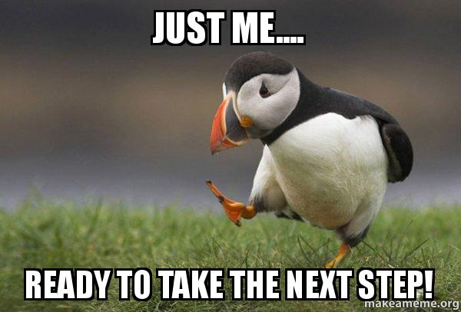
Next steps

Slide 13

Recommended Next Steps
Initially, this research was going to include 1:1 interviews to fill knowledge gaps. However, after seeing what we know so far about lunch research recommends the following approach:
Team reviews this deck and includes comments for any questions on the data
A brainstorming session is held with the lunch team to identify ways to align to the top considerations and needs of lunch orderers
Design creates mock-ups based on the top 2-3 ideas developed
We host 1:1 interviews where Cx react to the mock-ups we provided
  Interviews to include Cx who:
    Rarely order lunch
    Order lunch regularly but not on DoorDash
    Order lunch on DoorDash

Slide 14
Thought starters for brainstorm…
What if we…
Create a badge or carousel for “quick prep” or “easy pickup”
Provide “ready made” options in DashMarts with guaranteed delivery times
Create an <15 mins filter for the lunch rush and highlight ready-made items
Ensure Rx ordered 2 or more times are surfaced between 11-1PM
Provide a lunch “challenge” order 3 lunches, get free delivery on the 4th
Work with quick prep Mx to provide lunch-specific rewards

Slide 15
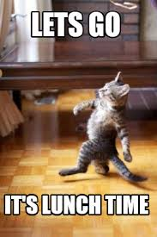
Thank you!

Slide 16
Appendix

Slide 17
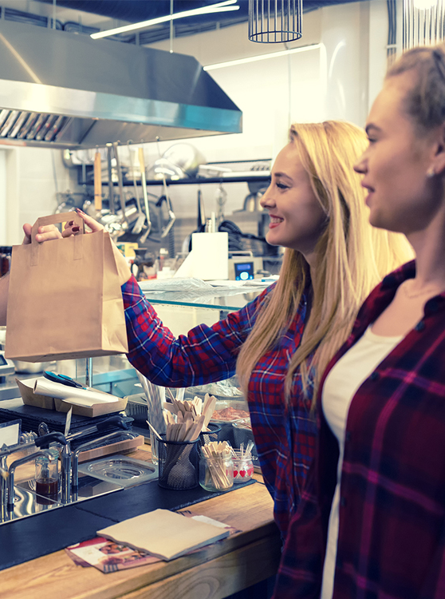
Lunch Pickup (3%)
It happened again - You woke up to an empty calendar and by the time you arrived at the office you’re back-to-back all day with the exception of one 30 minute gap for lunch. While you listen to a meeting that should have been an email you debate over Mexican or that salad place a few blocks away. Ultimately the Mexican place wins out and you’re out the door to pick up lunch during your half hour of solitude. You pick it up because this is your only time window and you have to be sure it is ready when you are free, and you don’t trust a delivery person to be able to find you in the maze of buildings.
DEPRIORITIZE:
nearby, out and about

Slide 18







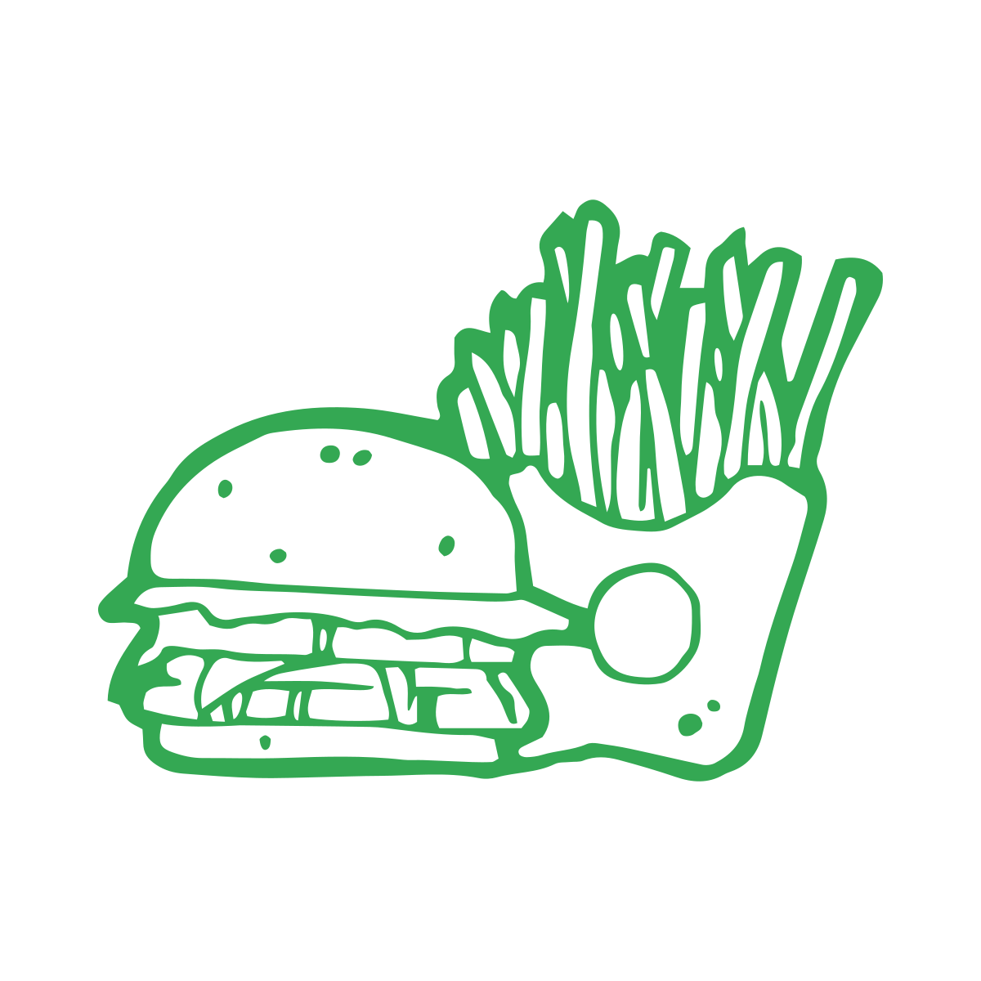


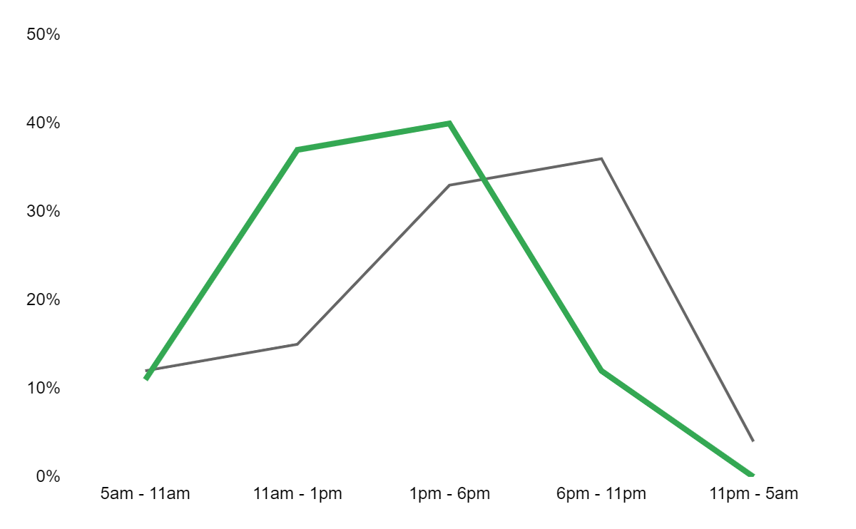


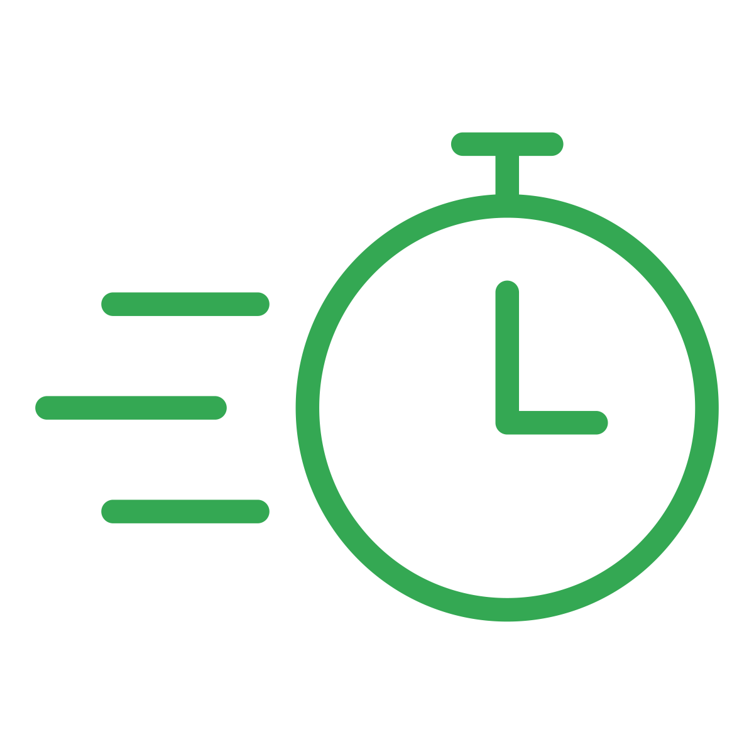


Solo Lunch Rush
Who?
What?
Where?
Home
(75%)
Office
(15%)
Mexican (18%)
Sandwiches (11%)
Eating alone (74%)
Eating w/ partner (18%)
Why Pickup?
Fast food (10%)
Rx was nearby
(72%)
The Rx will keep more of my money (19%)
When?
Descriptors/ Feelings
Routine meal (89%)
Unplanned
(79%)
Top Rx Considerations
Proximity
(46%)
Speed
(43%)
Feeling Hangry/ Hungry (57%)
Stressed/ Rushed (20%)

